Slide 1
CAMARA EdgeCloud Meeting 23rd January 2024

Slide 2
INSERT SUBHEADING
Agenda
Goal before MWC. Have an agreement on first version on LCM and Discovery APIs.
Harmonization of concepts/items among Simple Edge Discovery/MVP/Traffic Influence
Continuation on discussion PR159 With User stories
Minor changes on MVP EdgeCloud_LcM after approval of (PR 154)
Cleaning status of auxiliary branches

Slide 3
Goal before MWC. Have an agreement on first version on LCM and Discovery APIs.
Although no specific meetings of EdgeCloud APIs expected in MWC, a goal to go there with at least candidate final versions for EdgeCloud APIs:
Traffic Influence. Ready just with doc changes maybe after the discussions on harmonization of namings.
Life Cycle Management. With some pull requests open over minor issues and improvements
Discovery.
We could go for first version with current simple Edge discovery.
To be clarified if this a completely separated API, intented for end users or application providers, and share or not authentication mechanisms and credentials with LCM and TI APIs.
To be agreed roadmap on Discovery for future versions
Potential roadmap for future releases:
Extend Discovery capabilities ( potentially covering case of best existing app endpoint)
Extend granularity in LCM
Include resource reservation in LCM

Slide 4
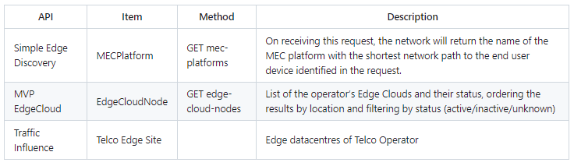
2.- Harmonization of concepts/items among Simple Edge Discovery/MVP/Traffic Influence
Issue 163 Harmonization of Edge Entitys among EdgeCloud APIS for future merge
Note: TI API. Just references in documentation no change of code required
Last proposals:
+ EdgeCloudSite: It may not be abstract enough.
+ EdgeCloudZone: To clarify and define if it is composed of several locations (sites) or just a single “location”.
Needed to generate a diagram of relationship.
Current granularity of region could be extended to (availability) zones, there would be several EdgeCloudZones within an (availabilty) zone?

Slide 5
3.- Other implementation details
Review discussion in PR PR 159
Continuation of discussion in previous meeting
Work pending in edge_terminology.md
User stories to clarify possible behaviours
Review of other topics from last comments in open pull requests

Slide 6
4.- Minor changes on MVP EdgeCloud_LcM after approval of (PR 154)
Several pull request created:
PR 165: Add location header in POST app response
PR 166: Virttype and image types options
PR 168: Improving descriptions of schema related with artifacts URI
Review of other topics from last comments in open pull requests

Slide 7
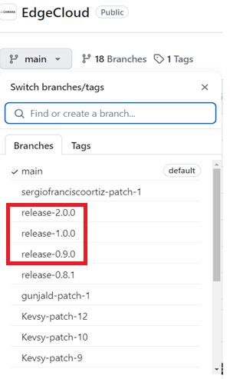
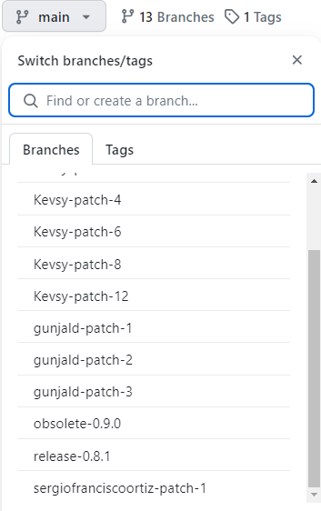
5.- Cleaning status of auxiliary branches
Branches at 9th of January
Branches at 23rd of January

Slide 8
Backup

Slide 9
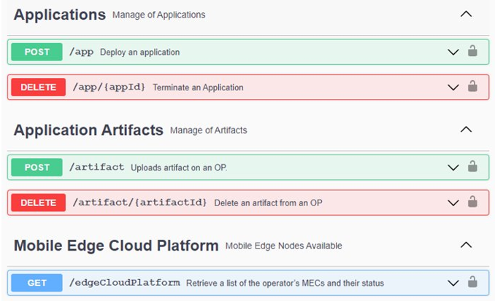
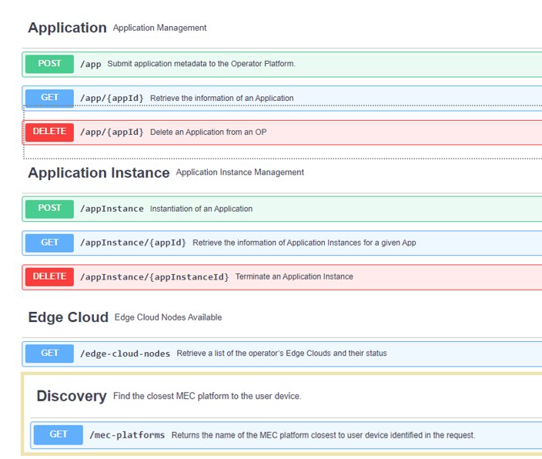
4.- Main changes in EdgeCloud MVP following.
Goal Merge into main branch and include further changes in separated PRs.
Combined Artifact and Application into a single type
Added get methods for Application and AppInstances ( included status for app instance)
V0.1.0
V0.2.0

